Slide 1
Lab 4

Slide 2
Purpose
To demonstrate knowledge of
Generics
Collections

Slide 3
Collections & Generics
Replace the Customers array with an appropriate collection
The collection must be typesafe

Slide 4
Sorting
Create a new class, CompareByJoinedDate, which provides the necessary code to allow the Customer collection to be sorted by joined date
Generate the report sorted by joined date.

Slide 5
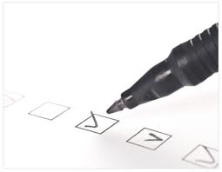
Checklist
I have:
Met all the functional requirements
Followed the java coding conventions
Used a file template to add my name & student number to all source files
Used packages; the root package is my student number, ex. package a00123456…;
Used great object-oriented design
Run “Source > Format” on my project
Included all source code & required resources
Created a runnable Jar file for testing
Zipped up all my files into a single file named <your student number>.zip, ex. A00123456.zip
Submitted my lab before the due date & time

